Slide 1

CS445 Final Project Group 2 – Green Data Trees
Alexander Boyce Kyle Dennewith

Slide 2
About Us and our Project
Our group research aims to accomplish the following:
Investigate the market dynamics of the legal cannabis industry in the state of Connecticut and Washington State.
Focus on state-wide consumption patterns, market structure, and other social trends.
Q : Why this Topic?
A : The recent wave of state-level legalization across the county presents a novel regulated market distinct from long-established industries like alcohol, firearms, and nicotine products.
Q : Where did we find this data?
A : We will be utilizing multiple publicly available datasets from data.gov, and the State of Connecticut open data portal.

Slide 3
Technologies utilized
Pandas – Reading CSVs, data cleaning, aggregation, and reshaping
NumPy – Numeric operations like linear trends and moving averages
Matplotlib – Plotting library for bar plots, stackplots, line plots
GeoPandas – Reading and manipulating shapefiles, merging geographic data (ZIP boundaries, city points)

Slide 4

Visual 1 Alex Boyce
Cannabis Sales By Week

Slide 5
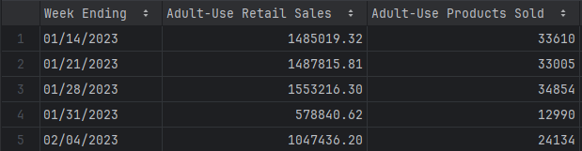
About the Data
Cannabis Retail Sales in Connecticut (2023–2025)
What is this data?
This dataset tracks weekly adult-use cannabis retail sales in Connecticut.
Covers the time period from January 2023 to April 2025.
Some of the data in : Cannabis_Retail_Sales_by_Week_Ending.csv
Motivating Questions:
What trends can be observed in weekly adult-use cannabis sales, and how do those trends evolve over time?
Can Cannabis sales be associated with any real-world events or holidays?
How do individual weekly fluctuations compare to the overall trend and short-term moving average?
Visual One - Cannabis_Retail_Sales_by_Week_Ending.csv

Slide 6
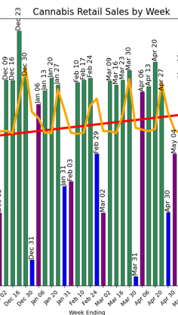
Observations
Cannabis Retail Sales in Connecticut (2023–2025)
Consistent Upward Trend
Retail sales have increased steadily from January 2023 to April 2025.
Red Linear trend line depicts slow but stable market growth.
Holiday Sales Peaks
Mid-to-late December experiences clear spikes in sales.
Likely tied to holiday season activity — consumers have more time off and may be purchasing for events or gifting.
Mid-Month Spending Sweet Spot
First (purple) and last (blue) weeks of each month show lower sales, even during high-performing months.
This may reflect budget constraints like rent, credit cards, and subscription renewals.
Seasonal Strength in August & September
August and September consistently show elevated sales volumes, excluding first/last week dips.
This might correlate with Late summer leisure activity, Back-to-school, and Fewer competing holidays, allowing cannabis to remain a discretionary spending priority.
Visual One - Cannabis_Retail_Sales_by_Week_Ending.csv

Slide 7
Visual 2 Alex Boyce
New Product THC & CBD Potency Over Time

Slide 8
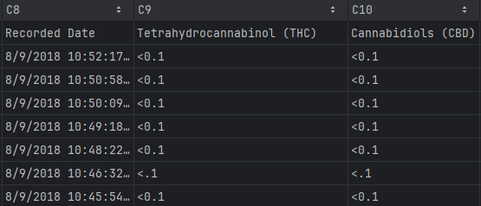
About the Data
Cannabis Product Chemical Composition and Potency in Connecticut (2015–2025)
What is this data?
This dataset contains chemical composition data for all new marijuana products being legally sold in Connecticut. Specifically, this dataset tracks the levels of Tetrahydrocannabinol (THC), Cannabidiols (CBD), Tetrahydrocannabinol acid (THCA), and Carboxylic acids (CBDA) in new products. Each entry includes a recorded date along with the percentage potency of the chemical in a specific product.
Covers the time period from January 2015 to April 2025.
Some of the data in : Cannabis_Brands_with_Chemical_Composition.csv
THC – Psychoactive; the main compound that causes the “high” feeling.
CBD – Non-psychoactive; known for therapeutic effects like reducing anxiety or inflammation.
THCA – Non-psychoactive; the raw form of THC found in fresh cannabis, turns into THC when heated.
CBDA – Non-psychoactive; the raw form of CBD, also converts to CBD when exposed to heat.
Motivating Questions:
How has the average Chemical Composition and Potency levels of newly released marijuana products changed over time?
Can indications of legislation change be seen in a visualization showing new products?
Visual Two - Cannabis_Brands_with_Chemical_Composition.csv

Slide 9
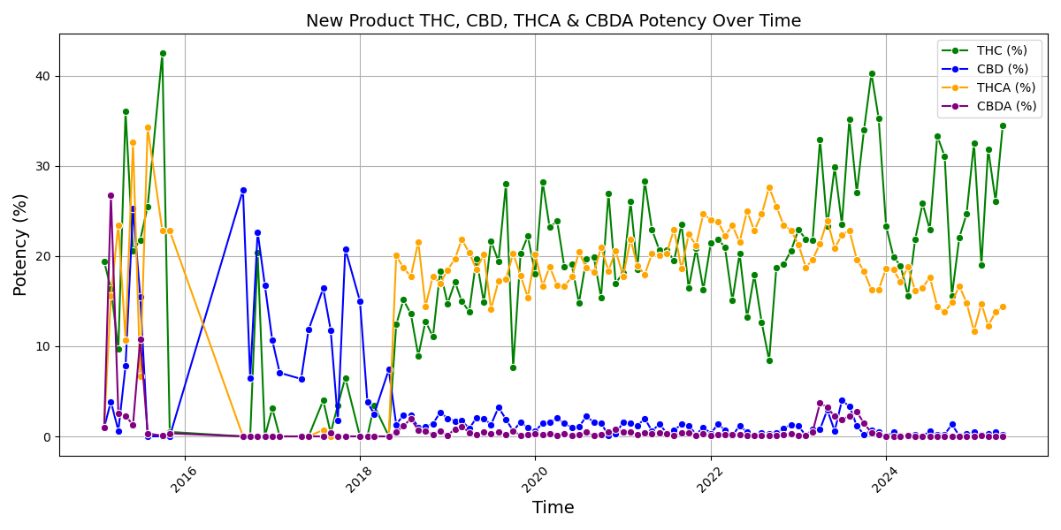
Visualization
Cannabis Product Chemical Composition and Potency in Connecticut (2015–2025)
Visual Two - Cannabis_Brands_with_Chemical_Composition.csv

Slide 10
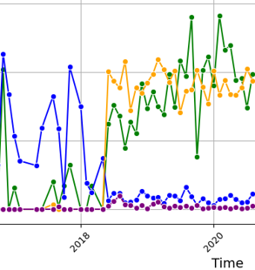
Observations
Cannabis Product Chemical Composition and Potency in Connecticut (2015–2025)
Significant production shift in 2018 – Likely tied to a legal or regulatory change
No visible impact from COVID-19 in 2020 – New product registrations remained steady
Overall increase in product submissions – Industry shows growth and expansion over time
THC & THCA potency trending upward – while fewer products, are registered, potency is intensifying
CBD & CBDA potency trending downward – Still the most commonly registered products
Visual Two - Cannabis_Brands_with_Chemical_Composition.csv

Slide 11
Visual 3 Alex Boyce
Monthly Cannabis Sales Volume by Product Category

Slide 12
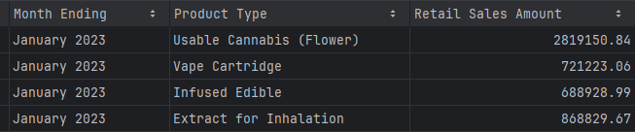
About the Data
Monthly Cannabis Sales Volume by Product Category (2023-2025)
What is this data?
This dataset contains monthly retail sales totals for cannabis products in Connecticut,
broken down by product category (e.g., flower, edibles, concentrates). Each entry includes the
"Month Ending" date, the product type, and the total dollar amount sold for that category in that month.
Motivating Questions:
How have consumer preferences for different types of cannabis products shifted in Connecticut over the past X years?
What is the most popular type of consumer cannabis product?
Some of the data in : Cannabis_Retail_Products_Sold_by_Product_Type.csv
Visual Three - Cannabis_Retail_Products_Sold_by_Product_Type.csv

Slide 13
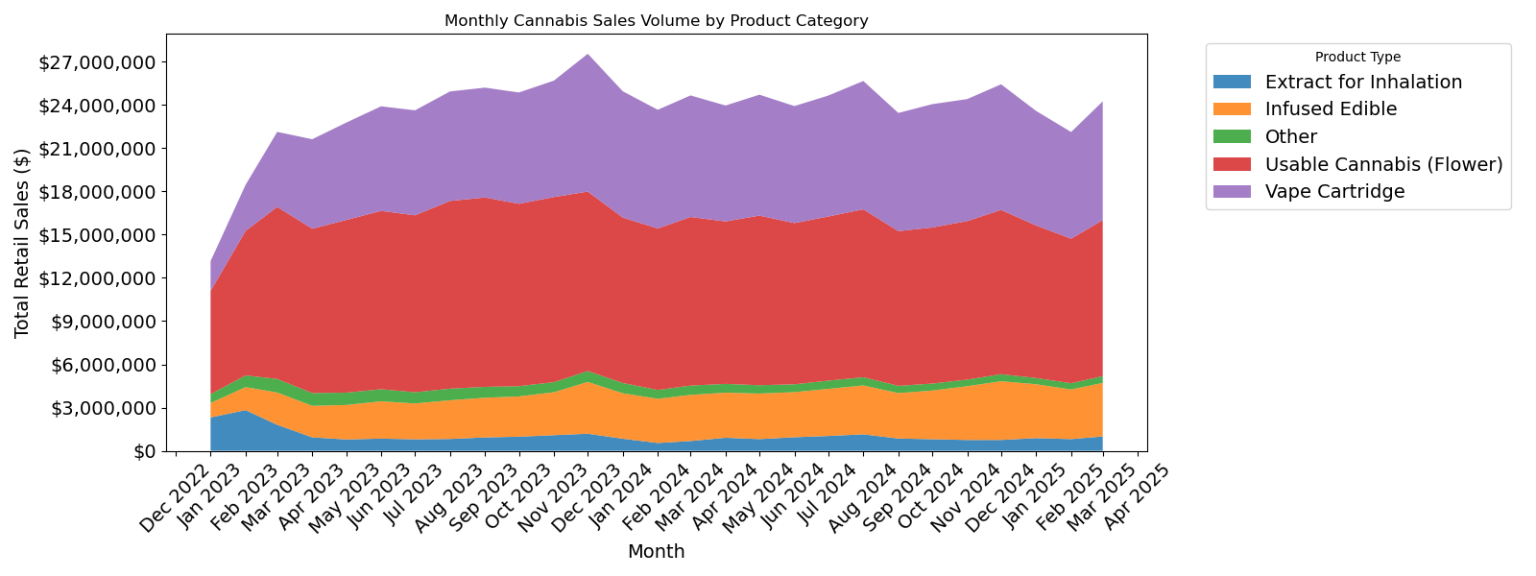
Visualization
Monthly Cannabis Sales Volume by Product Category (2023-2025)
*Other category includes: Pill, Capsule, Non Smokable Infused Extract, Tincture, Marijuana Infused Topicals, Liquid Marijuana RSO, Marijuana Mix Infused, Lozenge*
Visual Three - Cannabis_Retail_Products_Sold_by_Product_Type.csv

Slide 14
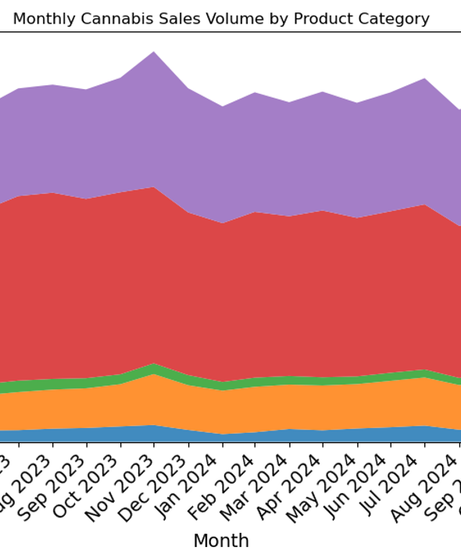
Observations
Monthly Cannabis Sales Volume by Product Category (2023-2025)
Vape Cartridges are the most popular product category,
Followed by Useable Cannabis, Other, Infused Edibles, and Extract for Inhalation
Sales volume has remained stable over time
Product type demand has shown little variation across months
Noticeable sales spikes occur in April and during the holiday season
Visual Three - Cannabis_Retail_Products_Sold_by_Product_Type.csv

Slide 15
Bonus MAP Visual Alex Boyce
Cannabis Retail Store Count by Connecticut Zip Code

Slide 16
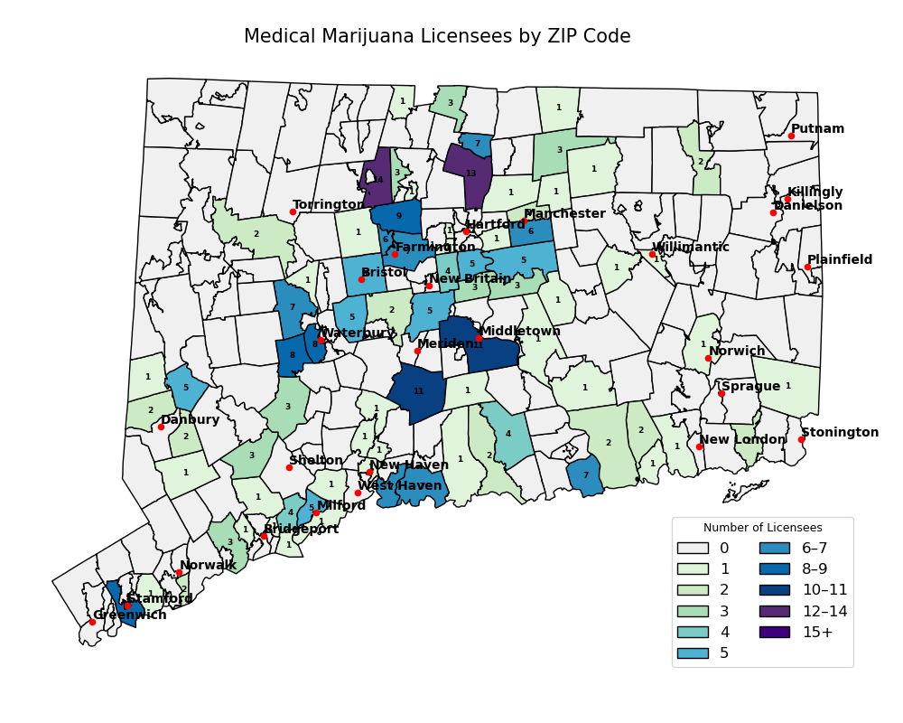
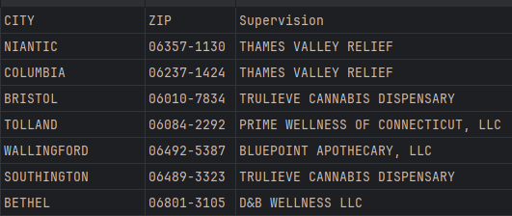
Bonus Map!
Cannabis Retail Store Count by Connecticut Zip Code
What is this map?
This dataset shows medical marijuana dispensary licensees in Connecticut. Geo-spatial shapefile data was used to match ZIP codes with map boundaries.
Motivating Questions:
Where in Connecticut are marijuana licenses concentrated?
Some of the data in : Medical_Marijuana_Dispensary_License.csv
Map Visual - Medical_Marijuana_Dispensary_License.csv

Slide 17


Slide 18
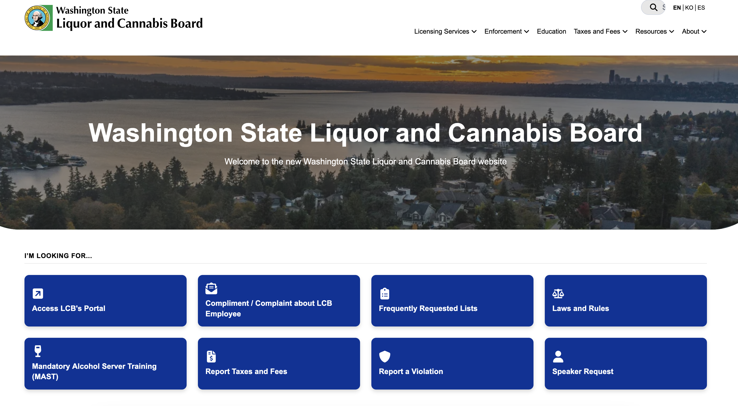
METHODOLOGY
Where the data came from:
Data Retrieval:

Slide 19
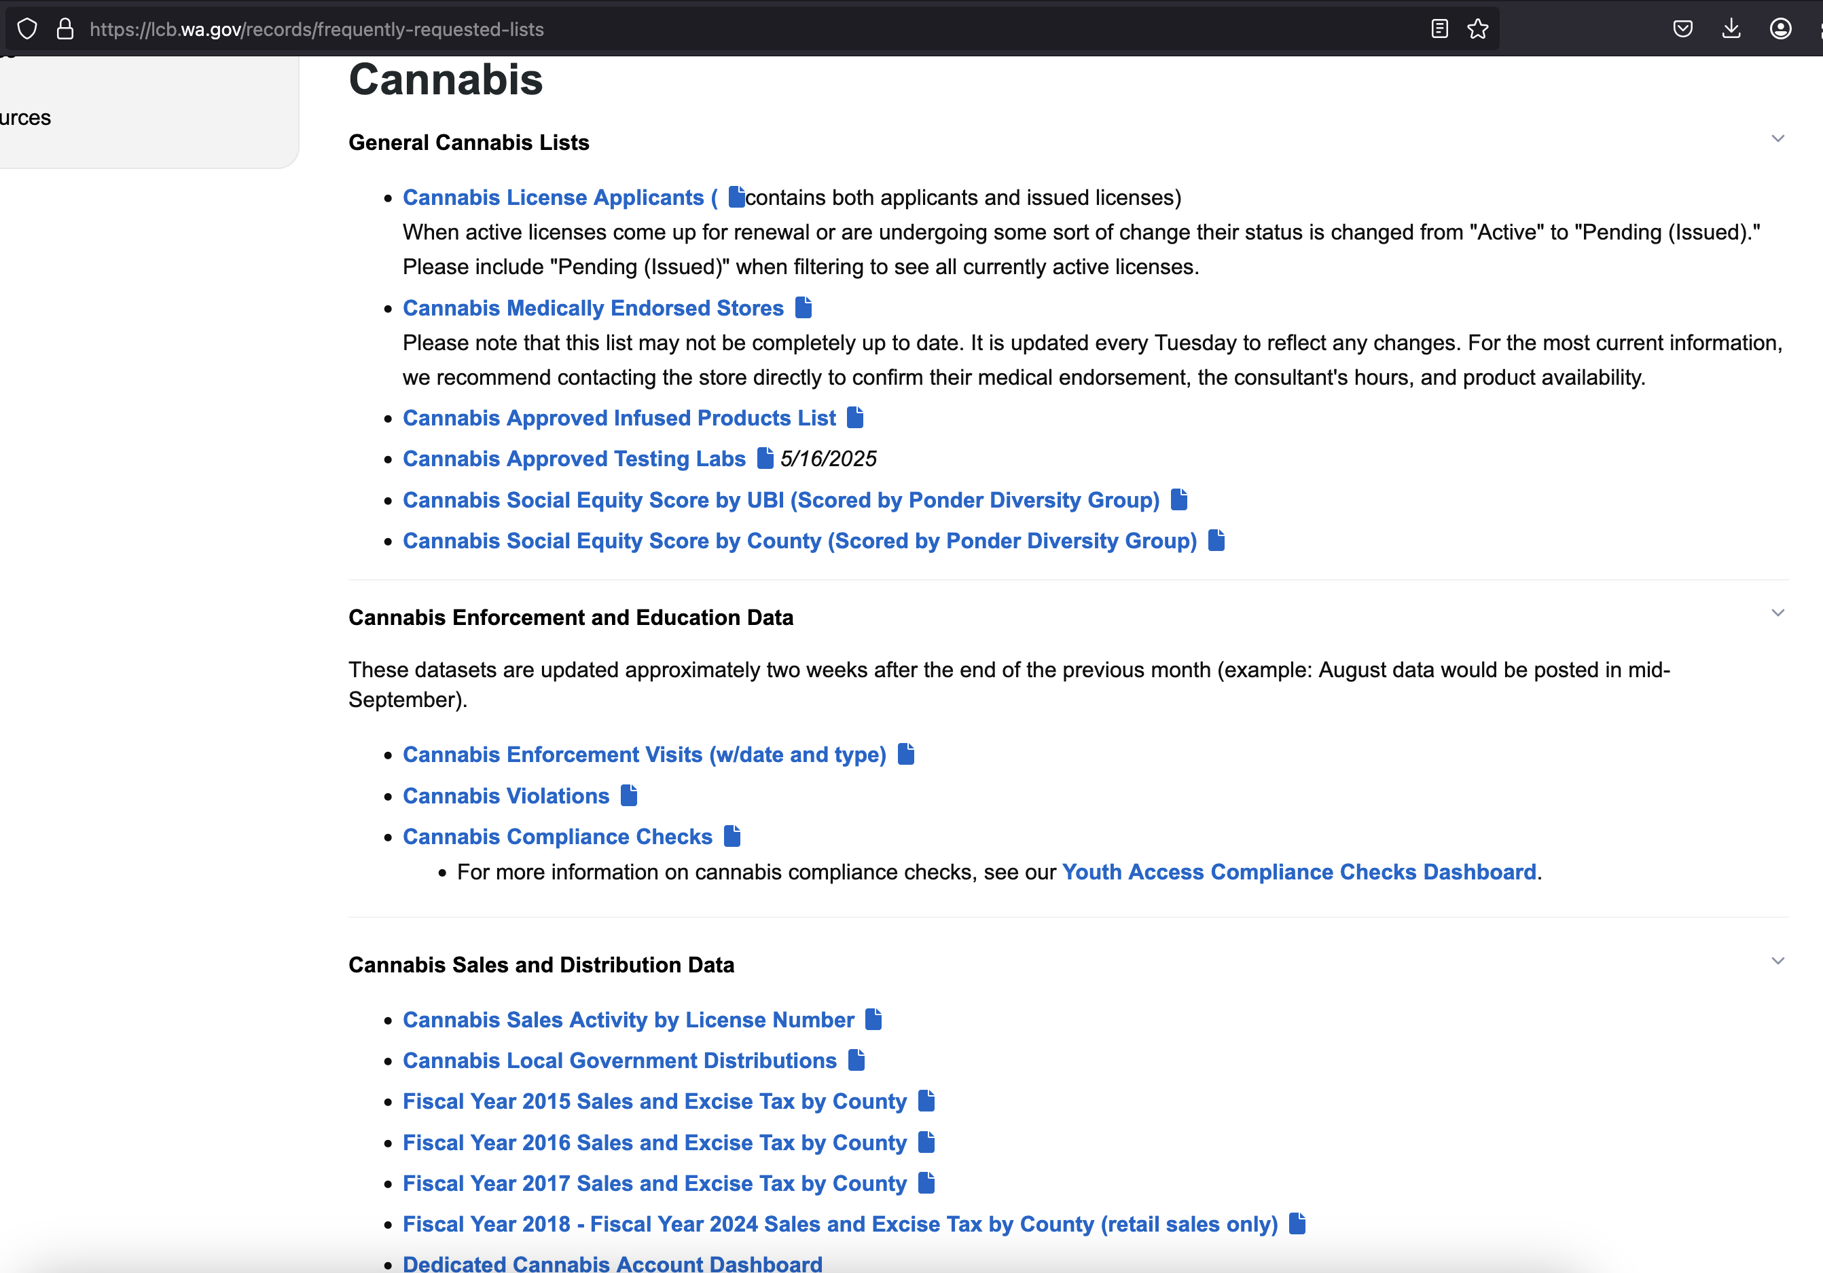
METHODOLOGY
Where the data came from:
Data Retrieval:

Slide 20
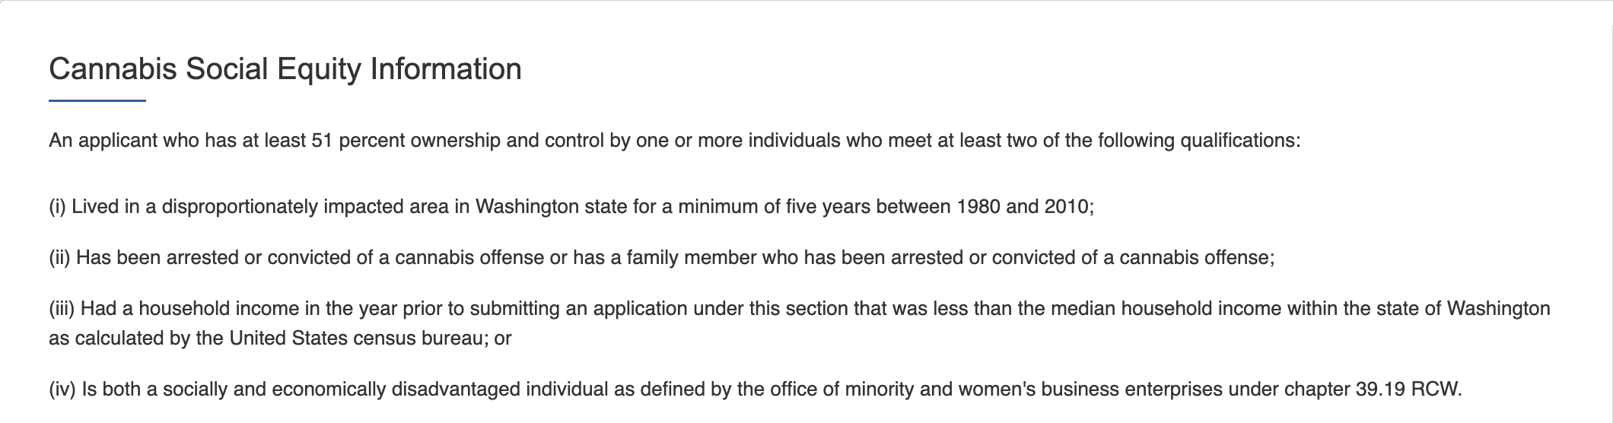
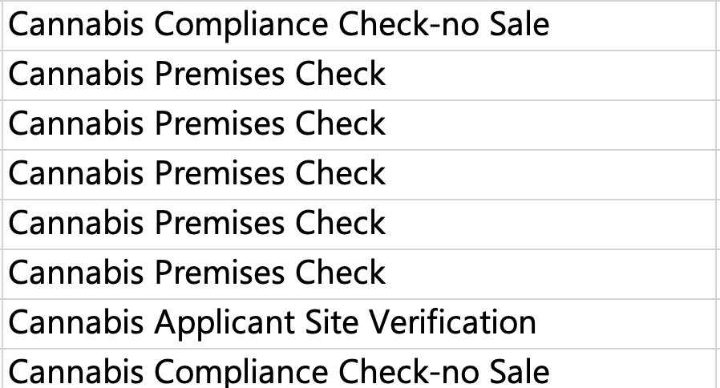
METHODOLOGY
What the Data Means
Data Retrieval:

Slide 21
Visual 4 Kyle Dennewith
Medically Endorsed Cannabis Retailers
and
Social Equity Score by
Washington County

Slide 22
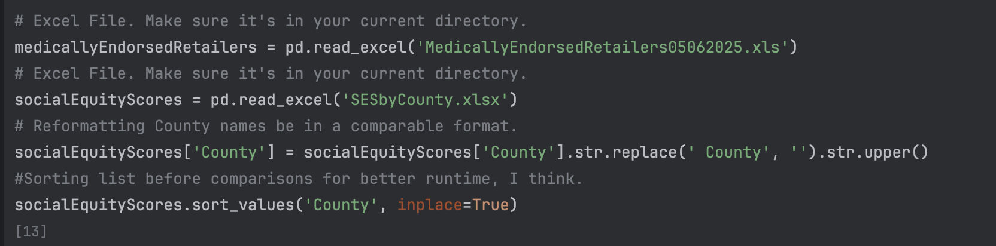
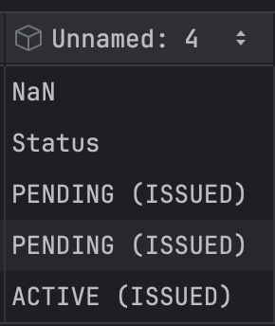
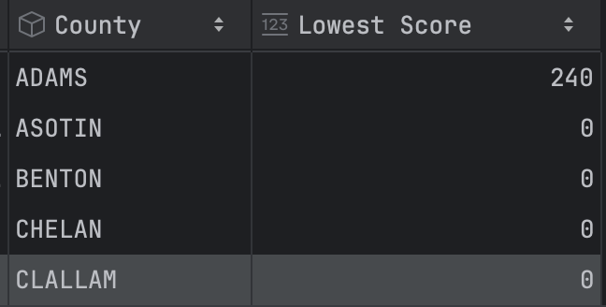
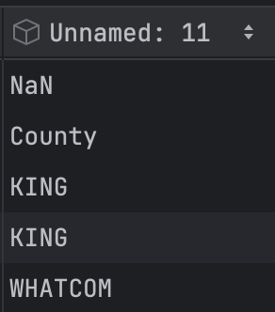
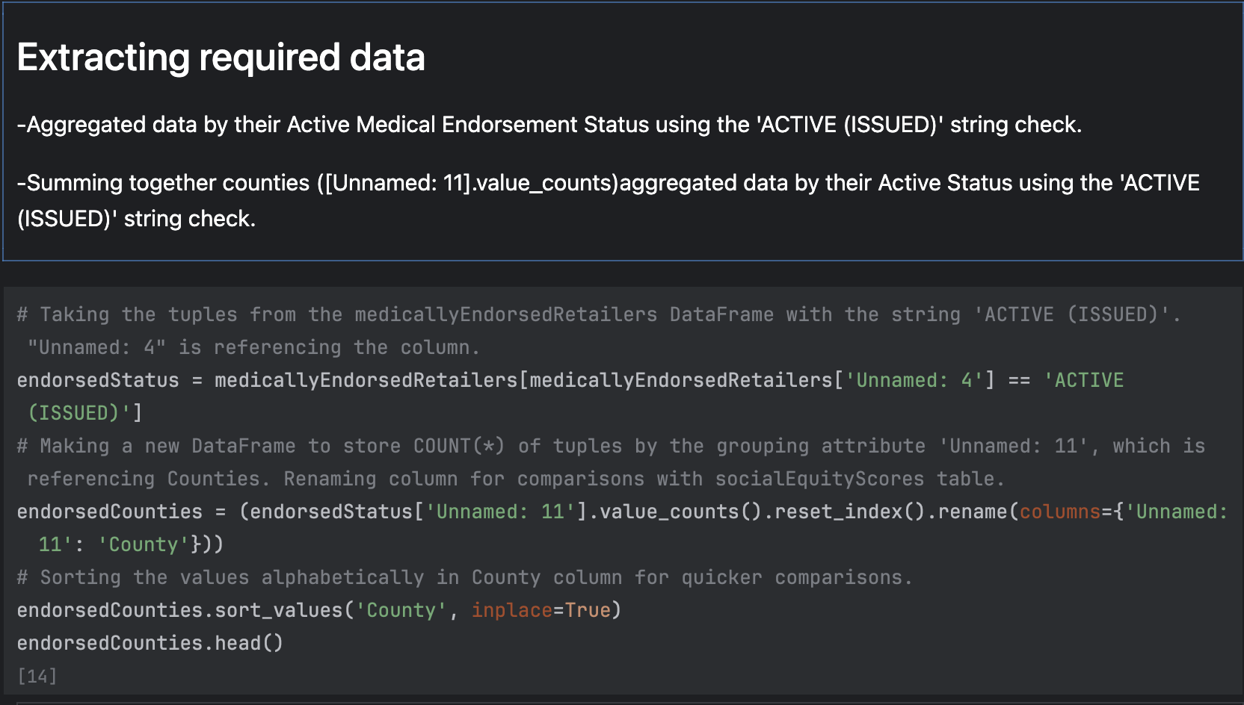
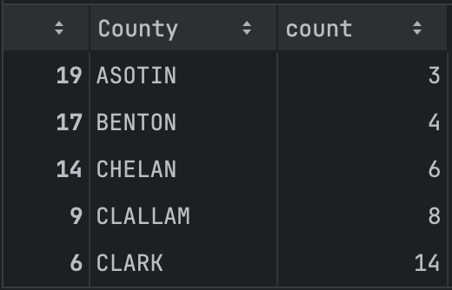
METHODOLOGY
medicallyEndorsedRetailers TABLES:
Medically Endorsed Cannabis Retailers and Social Equity Score by Washington County
socialES TABLE:
Data Retrieval:
endorsedCounties TABLE

Slide 23
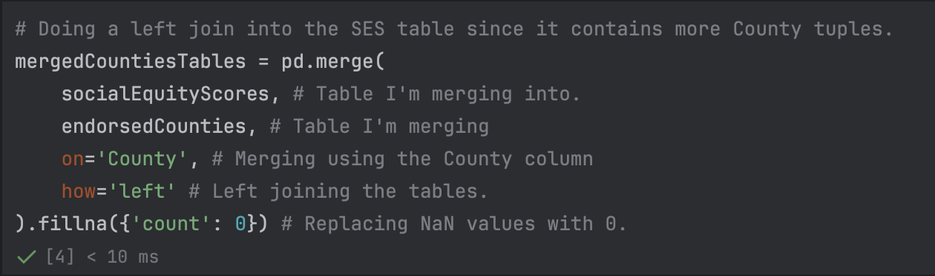
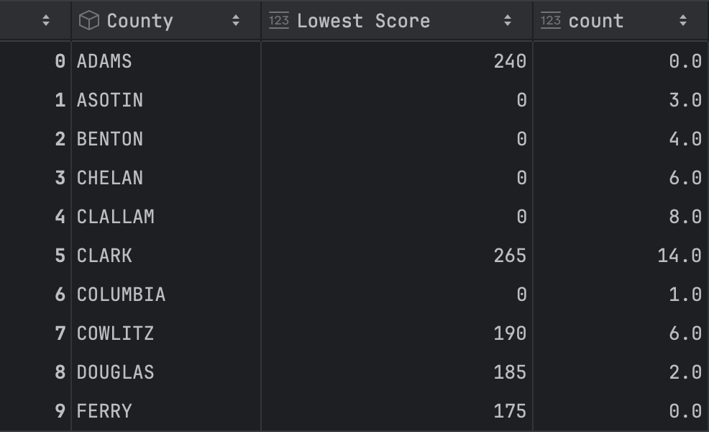
METHODOLOGY
Medically Endorsed Cannabis Retailers and Social Equity Score by Washington County
ON county
Data Retrieval:
socialES TABLE:
endorsedCounties TABLE
Merge

Slide 24
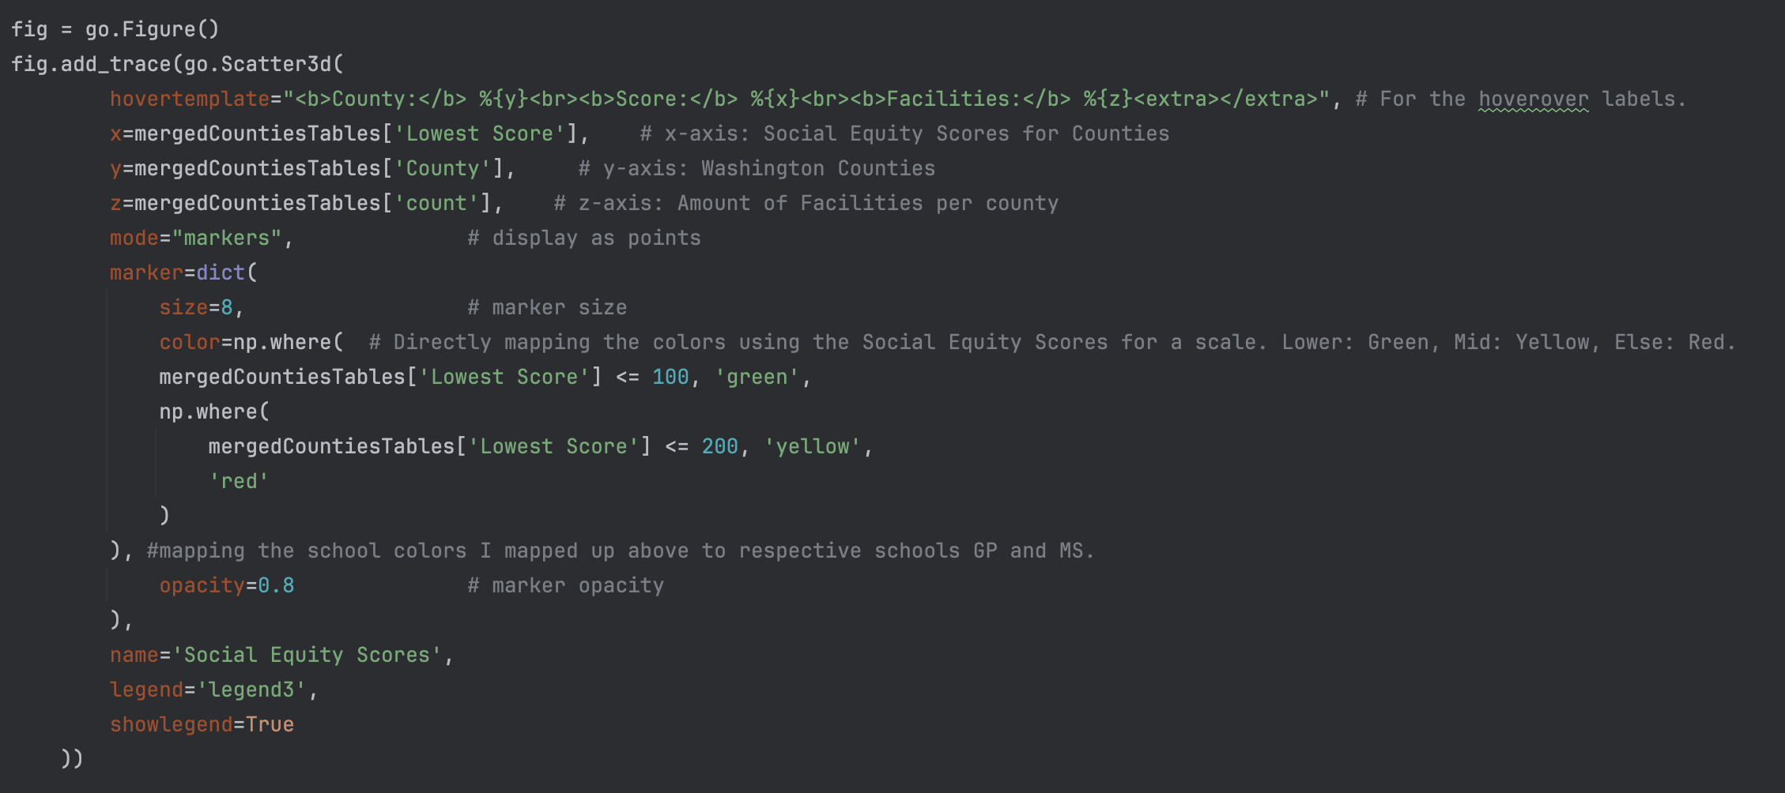
METHODOLOGY
Medically Endorsed Cannabis Retailers and Social Equity Score by Washington County
Data Retrieval:
mergedCountiesTables TABLE
Social Equity Score = mergedCountiesTables[‘Lowest Score’]
Social Equity Score <= 100, then green
Social Equity Score <= 200, then yellow
Else red

Slide 25
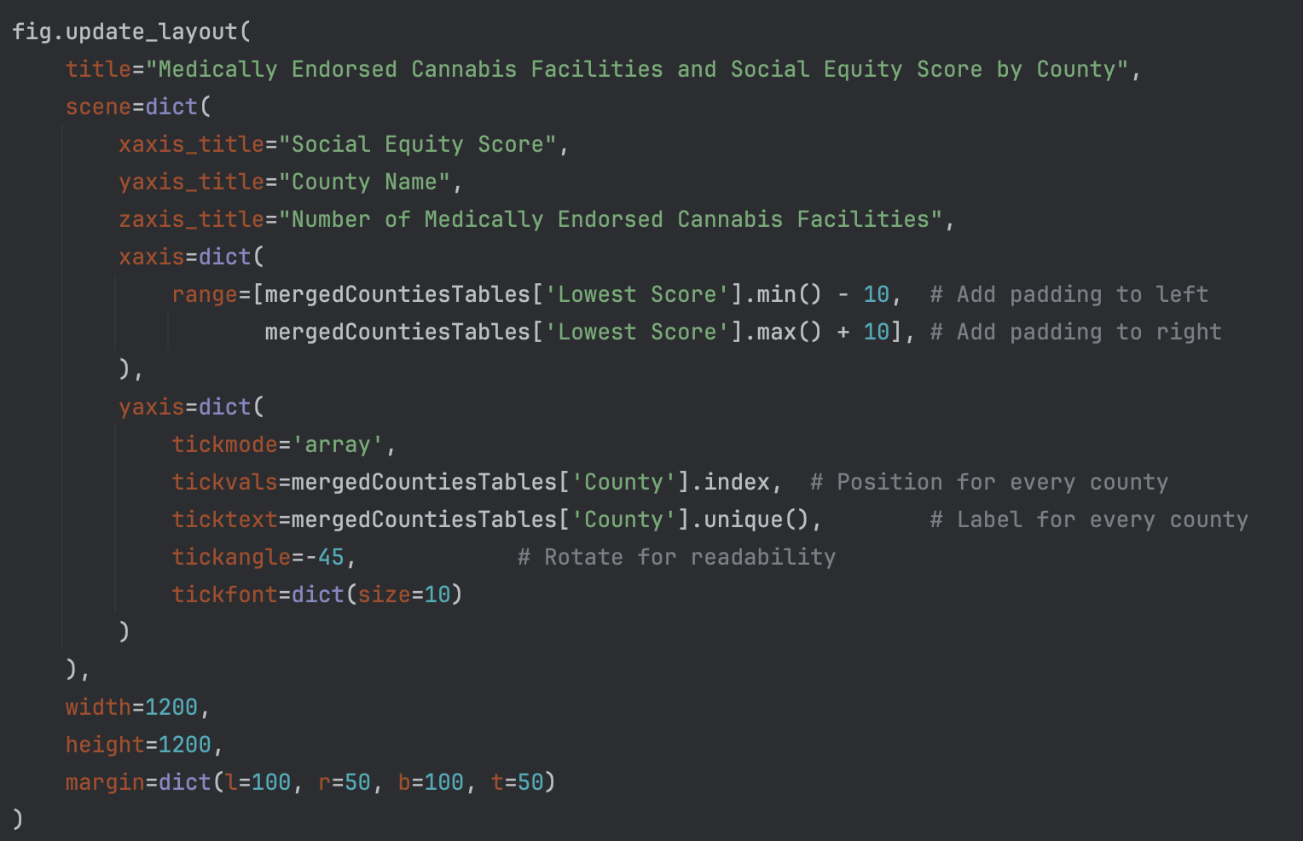
METHODOLOGY
Medically Endorsed Cannabis Retailers and Social Equity Score by Washington County
mergedCountiesTables TABLE
Data Retrieval:

Slide 26
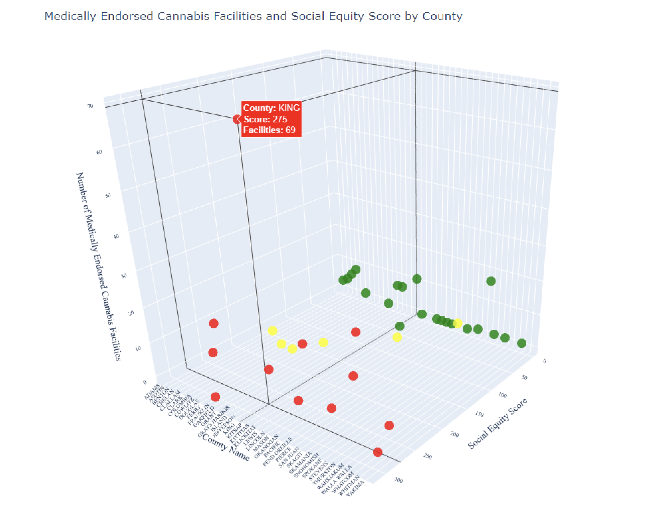
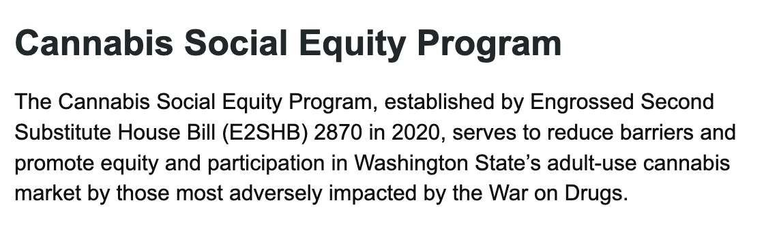
VISUAL
Medically Endorsed Cannabis Retailers and Social Equity Score by Washington County
Insights
King County has the most Facilities which relates to later Sales/Tax data
There are some counties including Adams County that have 0 Medically Endorsed Facilities.
Even with Low Equity scores many counties have facilities.

Slide 27
Visual 5 Kyle Dennewith
Washington Counties:
Police Activity and Social Equity

Slide 28
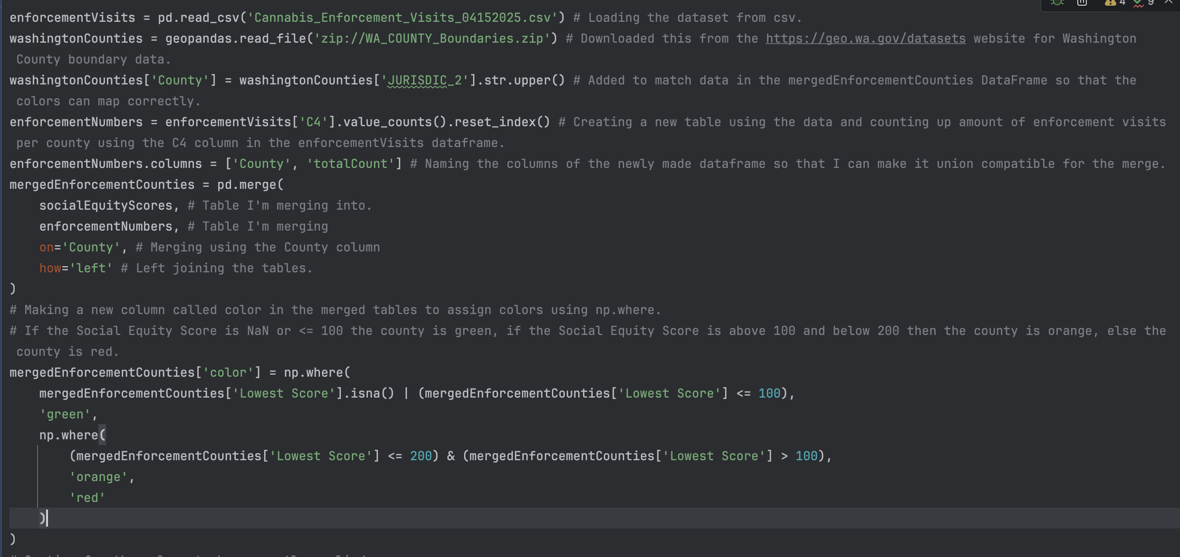
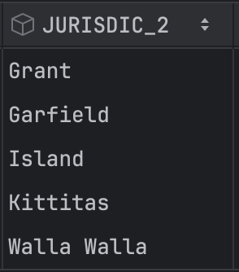
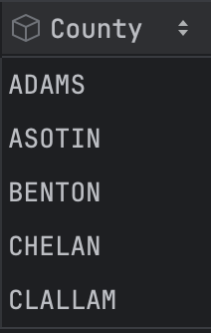
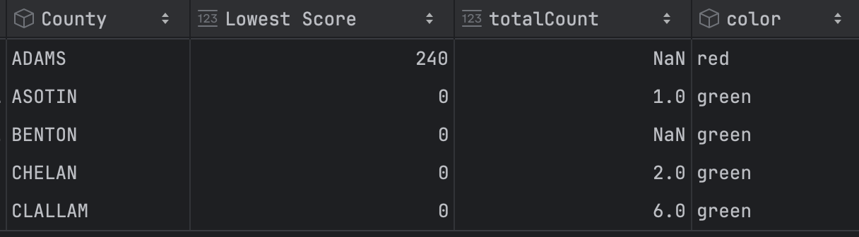
METHODOLOGY
Washington Counties:
Police Activity and Social Equity
Data Retrieval:
washingtonCounties[‘County’] TABLE
mergedEnforcementCounties TABLE after np.where():

Slide 29
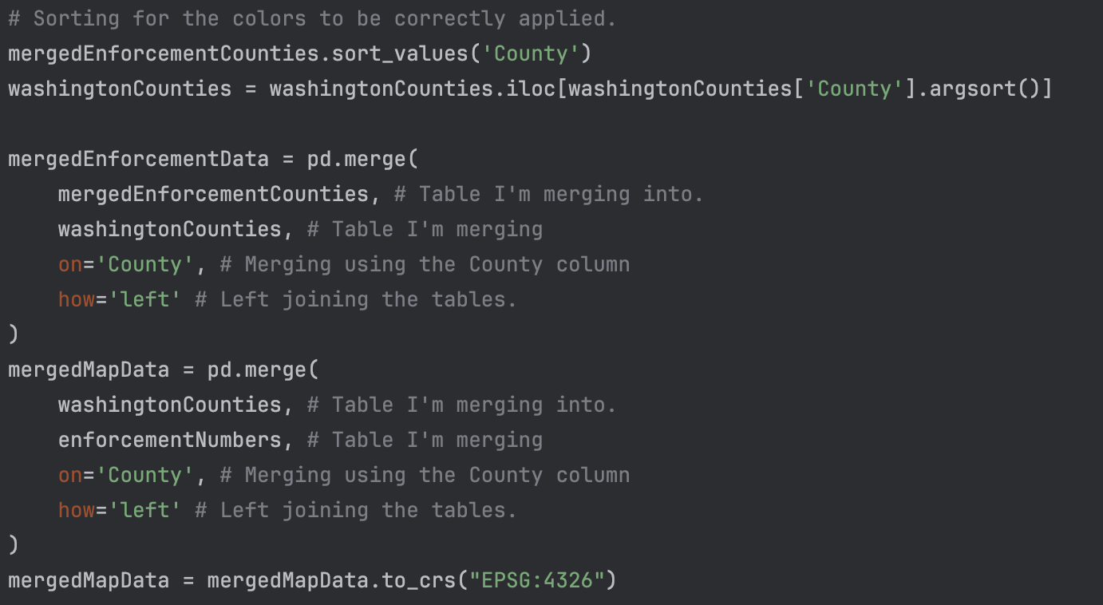
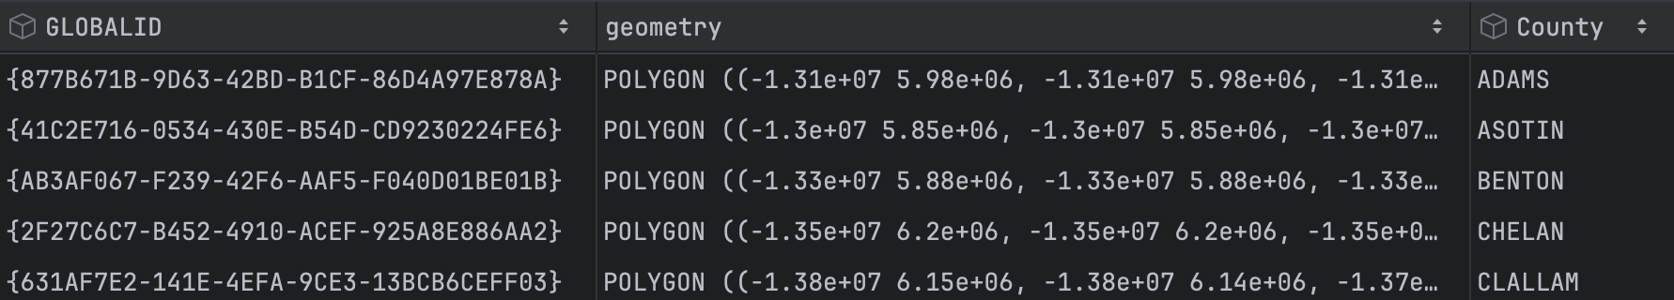
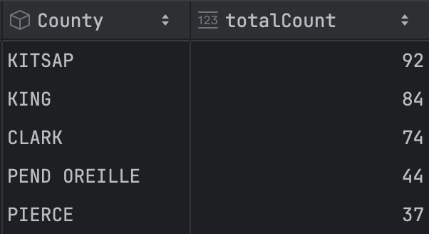
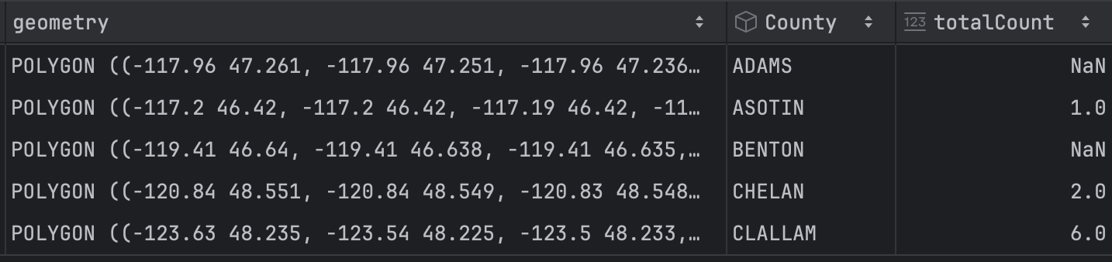
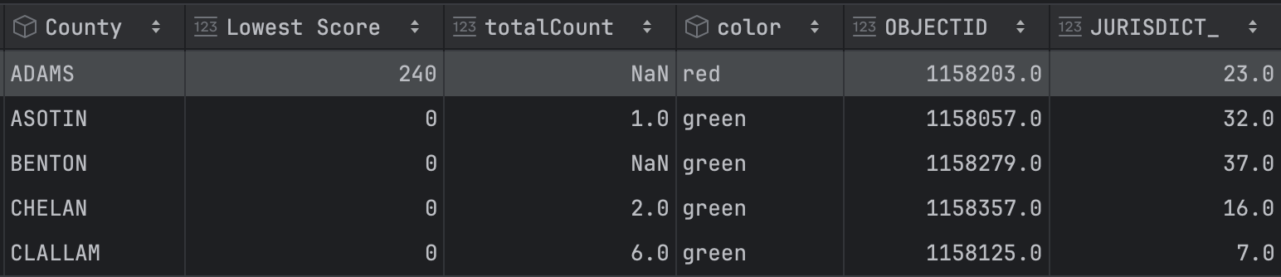
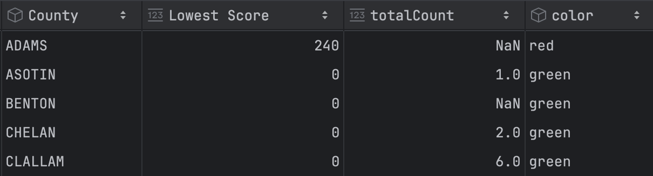
METHODOLOGY
Washington Counties:
Police Activity and Social Equity
Merge
mergedMapData TABLE
Data Retrieval:
mergedEnforcementData TABLE
Merge

Slide 30
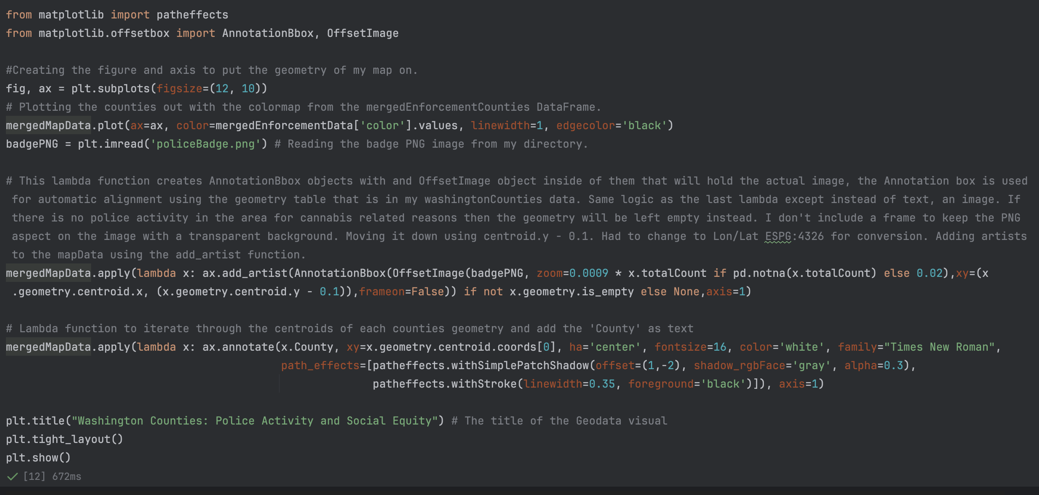
METHODOLOGY
Washington Counties:
Police Activity and Social Equity
Plotting/
Implementation:
Using the axis’s .add_artist() attribute with a Lambda function.
Each artist is a OffsetImage inside a AnnotationBbox both imported from matplotlib.offsetbox library.
Zoom is controlled by the current totalCount variable in mergedMapData DataFrame.
- if pd.notna(x.totalCount) then Zoom= 0.0009 * x.totalCount
- else Zoom=0.02
xy = ( x = centroid of x coord, (y = centroid of y coord – 0.1) ) and no frame.
- Subtracting -0.1 from y centroid to move policeBadge.png under text

Slide 31
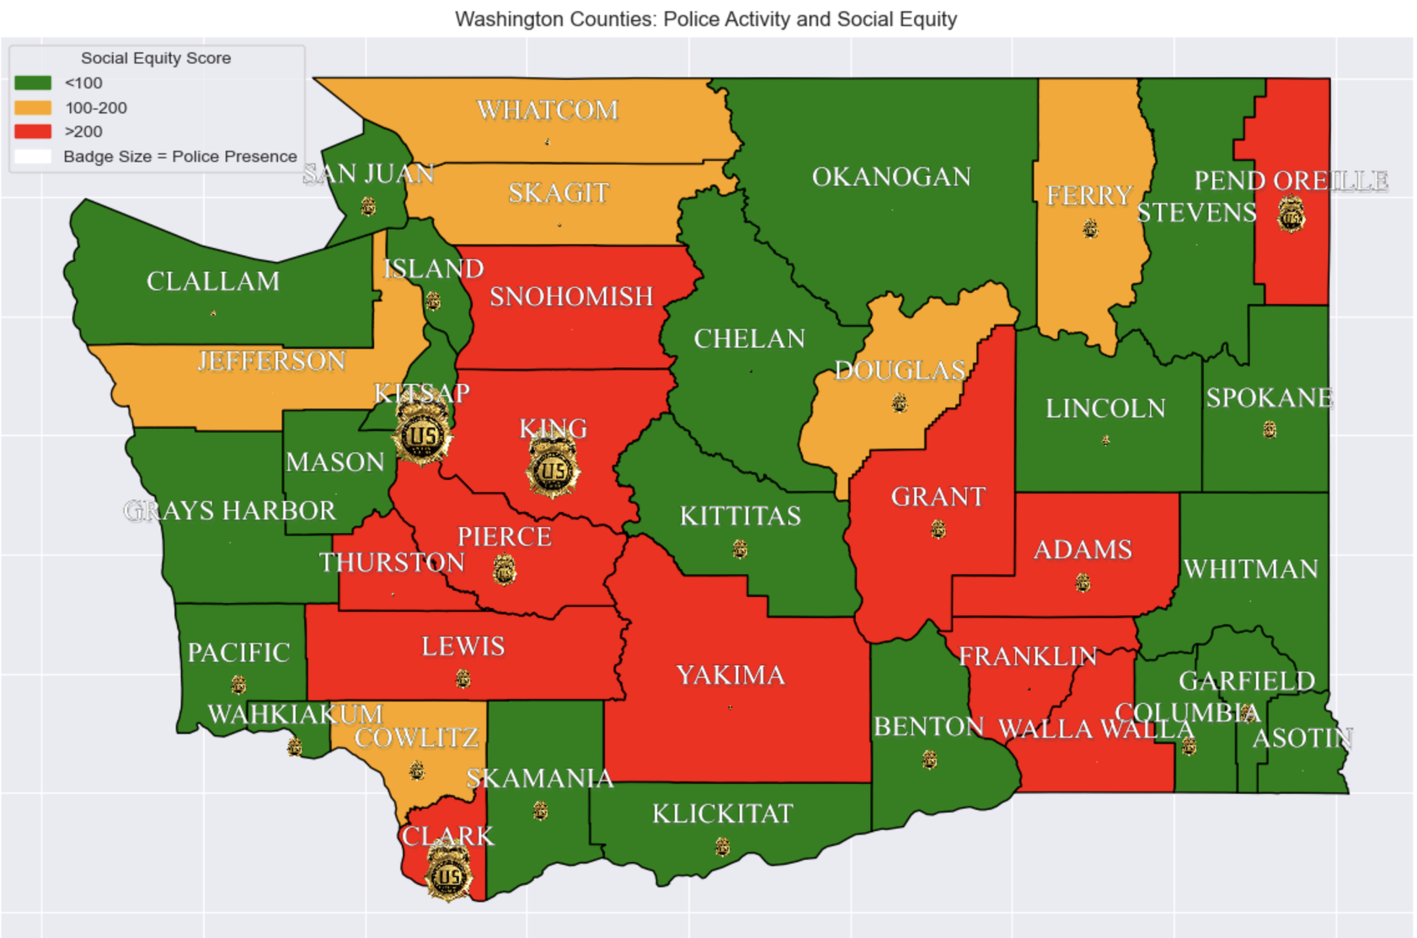
VISUAL
Washington Counties:
Police Activity and Social Equity
Insights
Cannabis related enforcement is very prevalent in Clark, Kitsap, and King county.
Moderate amount in Pierce, Grant, Adams, and Pend Orelle Counties
Yakima, Walla Walla, Franklin counties have a high social equity score but low cannabis related police activity.
Gives idea on what counties to focus on helping.

Slide 32
Visual 6 Kyle Dennewith
Total Cannabis Related Sales in Washington
by County/Year

Slide 33
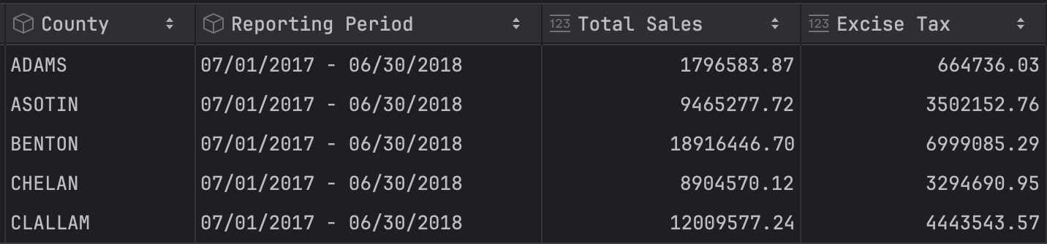
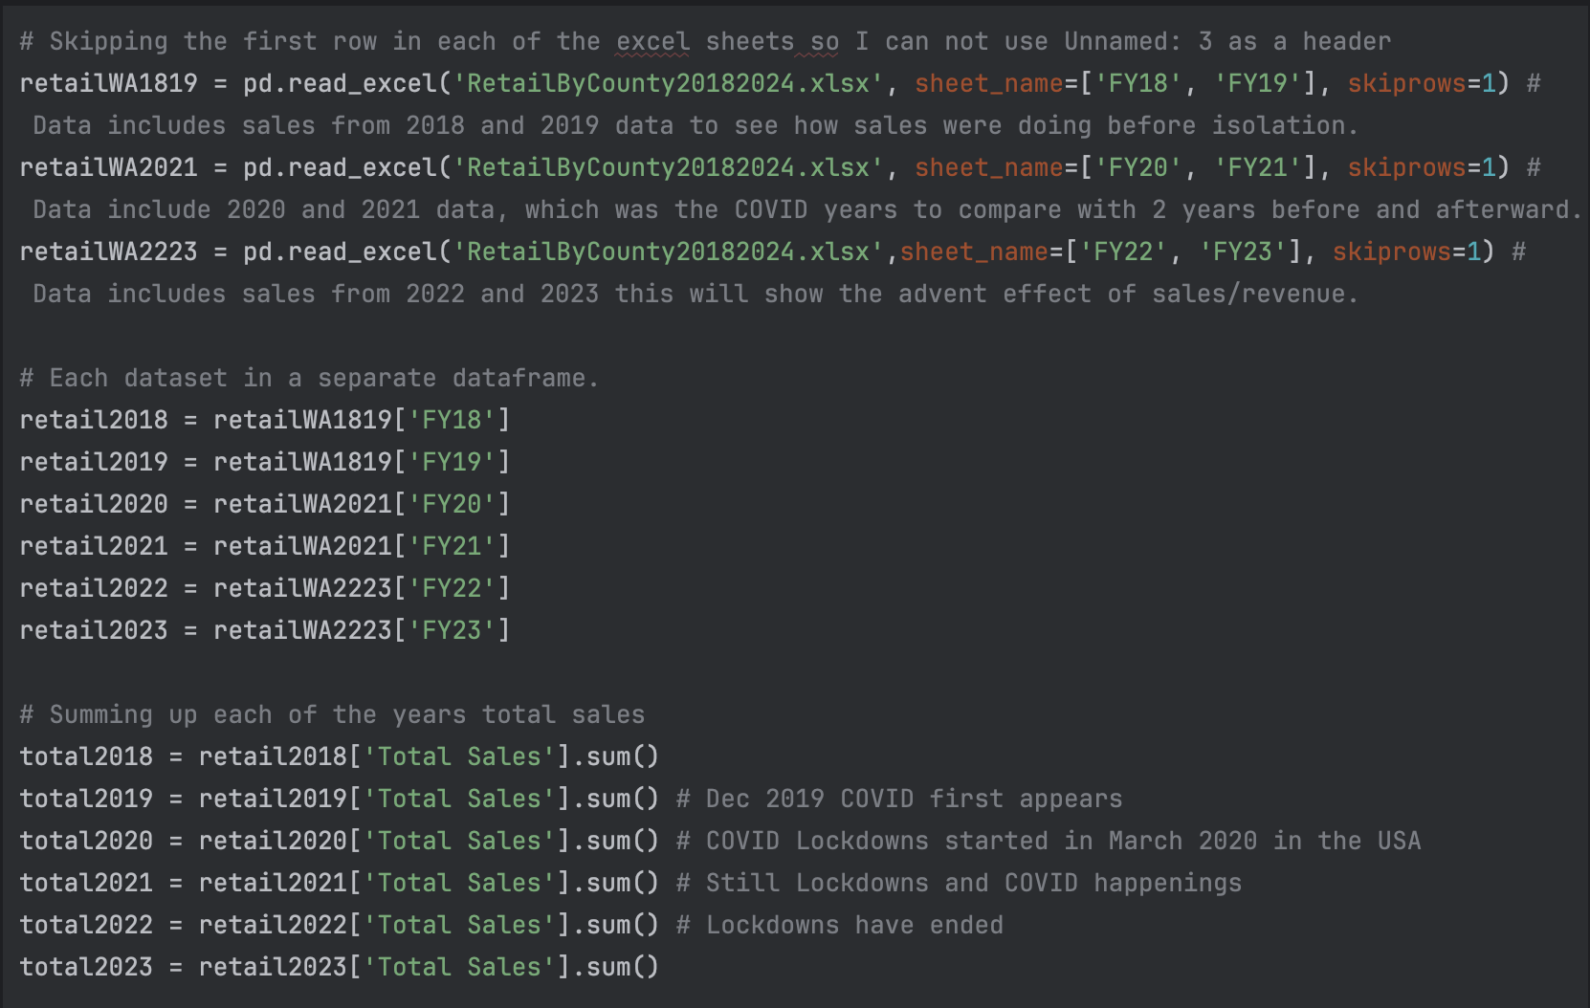
METHODOLOGY
Total Cannabis Related Sales in Washington
by County/Year
Pandas Dataframe TABLE format:
Data Retrieval:

Slide 34
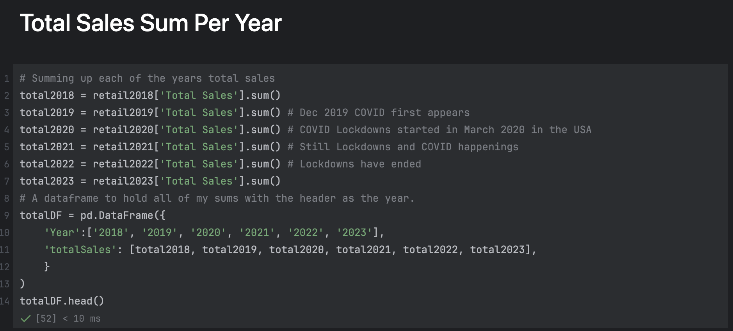
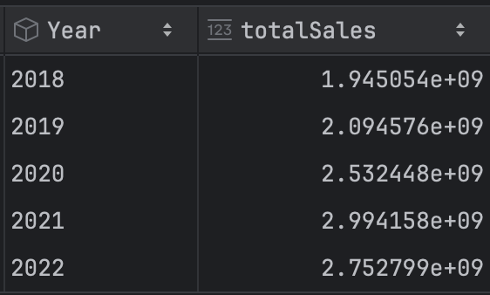
METHODOLOGY
Total Cannabis Related Sales in Washington
by County/Year
Data Retrieval:
totalDF TABLE

Slide 35
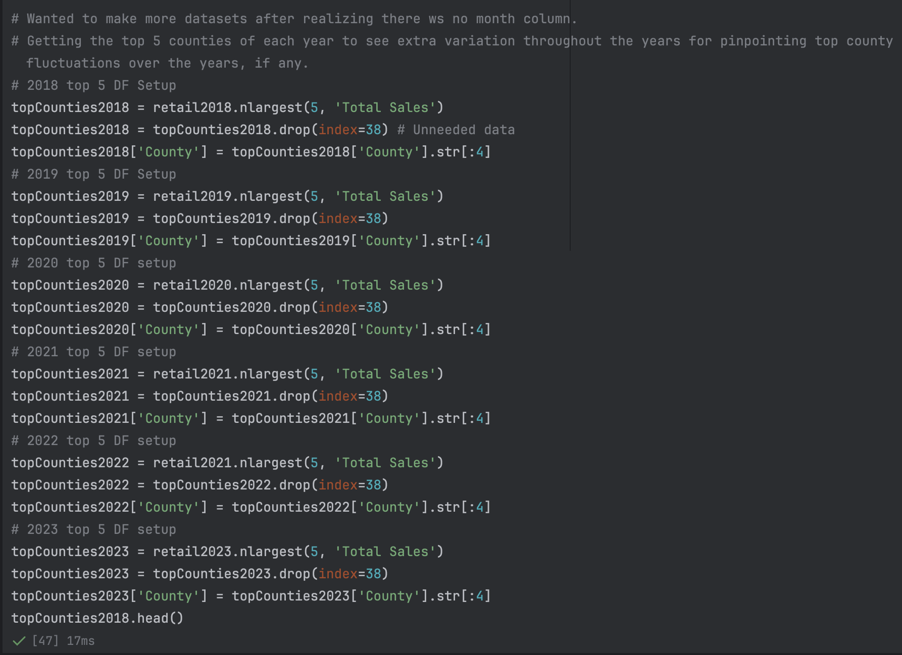
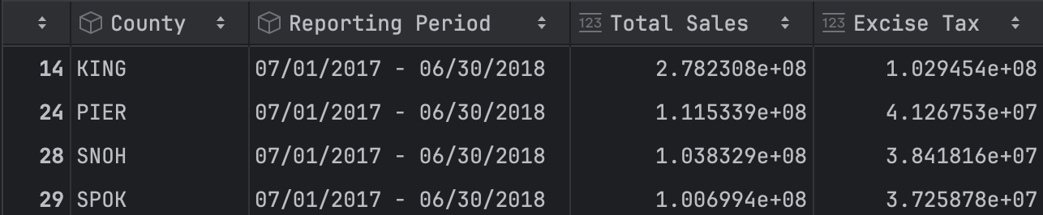
METHODOLOGY
Total Cannabis Related Sales in Washington
by County/Year
topCounties2018 TABLE
Data Retrieval:

Slide 36
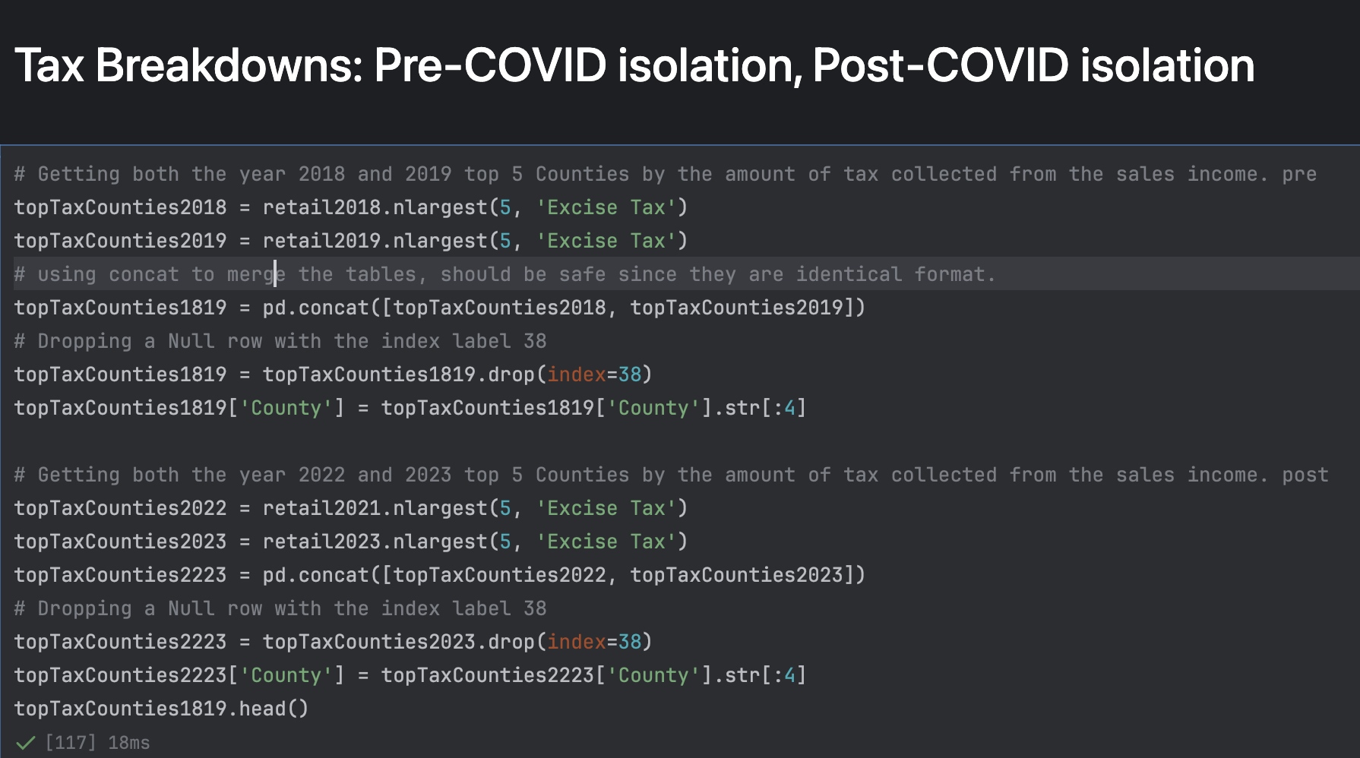
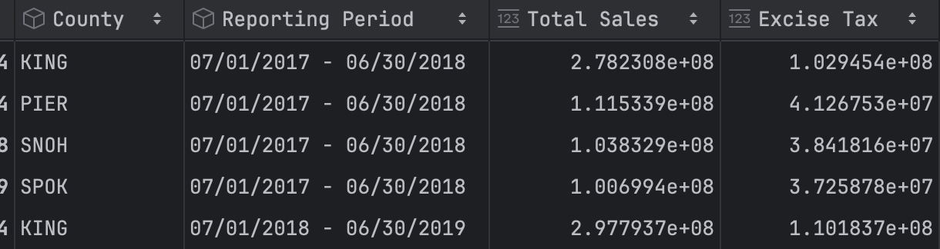
METHODOLOGY
Total Cannabis Related Sales in Washington
by County/Year
Data Retrieval:
topTaxCounties1819 TABLE

Slide 37
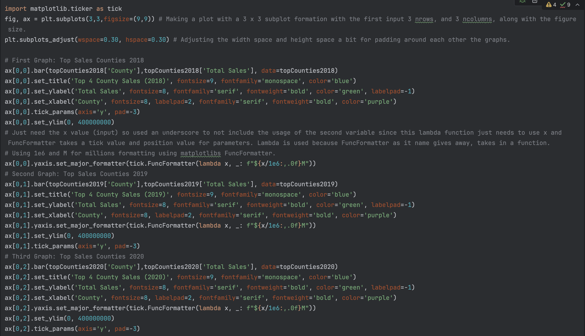



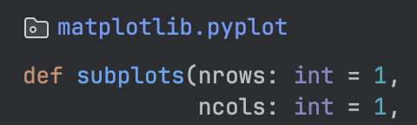
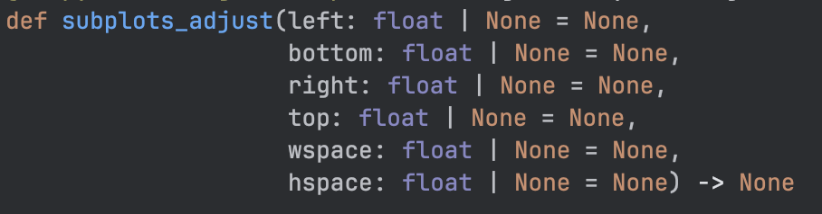
METHODOLOGY
Total Cannabis Related Sales in Washington
by Year 2018-2023
Axis Positions: First Row
Plotting/
Implementation:
Function: subplots
Function: subplots_adjust
Function: FuncFormatter

Slide 38
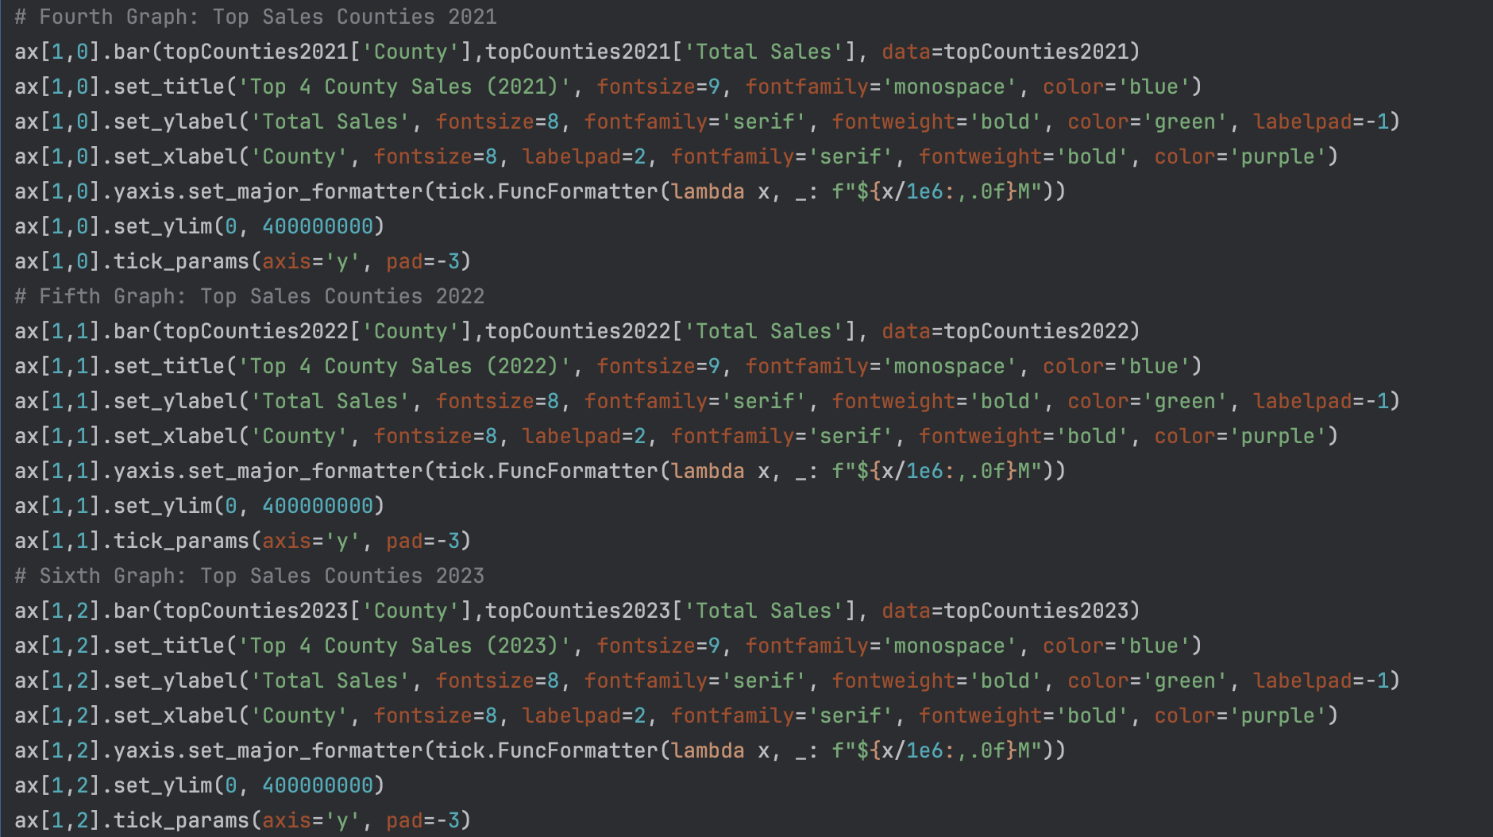



METHODOLOGY
Total Cannabis Related Sales in Washington
by Year 2018-2023
Axis Positions: Second Row
Plotting/
Implementation:
Normalization
Bar(x,y,data)

Slide 39






METHODOLOGY
Total Cannabis Related Sales in Washington
by Year 2018-2023
Axis Positions: Third Row
Plotting/
Implementation:

Slide 40

VISUAL
Total Cannabis Related Sales in Washington
by Year 2018-2023
Insights
Effect during COVID
Slow Fall off after COVID
King County plays big part in the economics of cannabis.
Tax Income increased 20 million in King County Alone
Total Sales in Washington reached almost 3 Billion

Slide 41
Thank you!

